Slide 2


Slide 4

Topic :
Online travel agent

Slide 5
members :
ABHIGYAN
Biswajeet
SIDDHARTH

Slide 6


Slide 8


Slide 9

TABLE OF CONTENT
1.OBJECTIVE
2.TECHNOLOGY USED
3.CLIENT SPECIFICATION
4.HARDWARE/SOFTWARE
REQUIREMENTS
5.CLASS DIAGRAM
6.SCREENSHORTS

Slide 10




Why use Odessey escapes?
A platform that offers budget-friendly accommodation options across India, with a wide range of hotels, resorts, and homestays.
We have partnered with many leading brands from the aviation & hospitality industries, creating fruitful partner relations for business expansion opportunities. We also entered the homestays & villas and continue to procure increased market share market in the same. With this, we also entered the ground transport space and commenced offering cab, bus & train booking services.

Slide 11
Why use Odessey escapes?
What makes our story even stronger is the performance of our newly launched segments, like —our comprehensive business travel suite and —an exclusive platform for travel agents. Entering the Gulf market is our latest feat, where we offer power-packed deals on flights & hotels.
We also have introduced a new feature in our website known as ChatBot, which gives users an interactive way to contact with our agent live when on the website for their doubts and any further queries about the travel packages & transportation.
It also aims to provide the comfort and necessary facilities nationwide and all over the world whether it just be India or any other part of the world guess what odyssey will be there.

Slide 12

Facilitiate Trip Planning
Booking Services
Reviews and Recommendations
Provide Users Safety And Security
Promotions And Deals
OBJECTIVE

Slide 13
6.Customer Support
7.Building Trust And Credibility
OBJECTIVE

Slide 14











technology used :

Slide 15
CLIENT SPECIFICATION
Facilitating Trip Planning: Offering detailed information about destinations, attractions, accommodations, transportation options, and activities to help users plan their trips efficiently.
Booking Services: Providing a platform where users can book flights, hotels, rental cars, tours, activities, and other travel-related services easily and securely.
Customization and Personalization: Offering personalized recommendations and customizable travel packages based on user preferences and interests.
Reviews and Recommendations: Including user-generated reviews, ratings, and testimonials to assist travelers in making informed decisions about their travel arrangements.
Mobile-Friendly Experience: Ensuring the website is responsive and optimized for various devices (smartphones, tablets, desktops) to allow users to access and navigate the site conveniently on the go.

Slide 16
CLIENT SPECIFICATION
Safety and Security: Ensuring that the website provides secure payment gateways and follows industry-standard security practices to protect users' personal and financial information.
Customer Support: Offering reliable customer service through various channels (live chat, email, phone) to assist users with inquiries, bookings, and support during their travels.
Promotions and Deals: Showcasing special offers, discounts, and travel deals to attract customers and encourage bookings.
Integration of Travel Resources: Integrating travel guides, maps, weather forecasts, visa information, and other useful resources to enhance the overall travel experience.
Building Trust and Credibility: Displaying certifications, affiliations with reputable travel organizations, and transparent policies to build trust among potential customers.

Slide 17

Hardware Requirements
monitor

Slide 18

Hardware Requirements
monitor

Slide 19

Hardware Requirements
monitor

Slide 20

Hardware Requirements
monitor

Slide 21

Hardware Requirements
1 GB RAM(min)
Intel i3 3rd gen (min)

Slide 22
SOFTWARE REQUIREMENTS
GOOGLE CHROME(recomended)
Or any other web browser
Os : windows 7 or higher

Slide 23
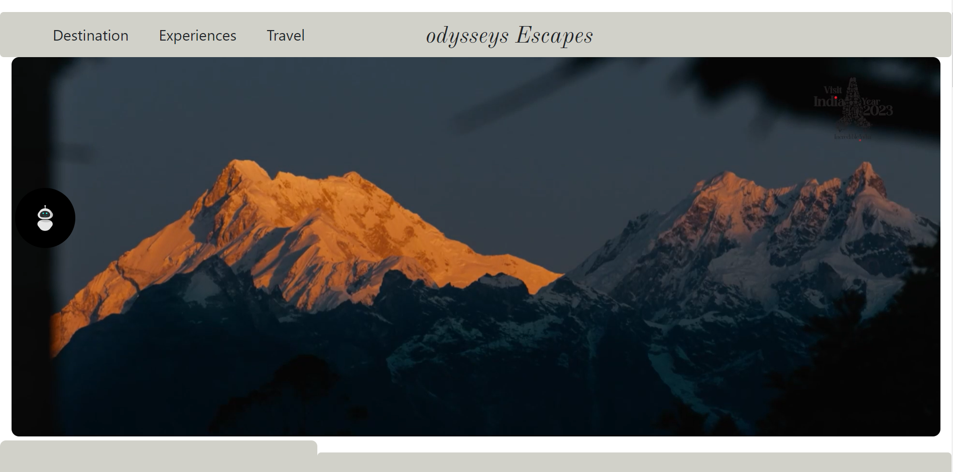
screenshots

Slide 24
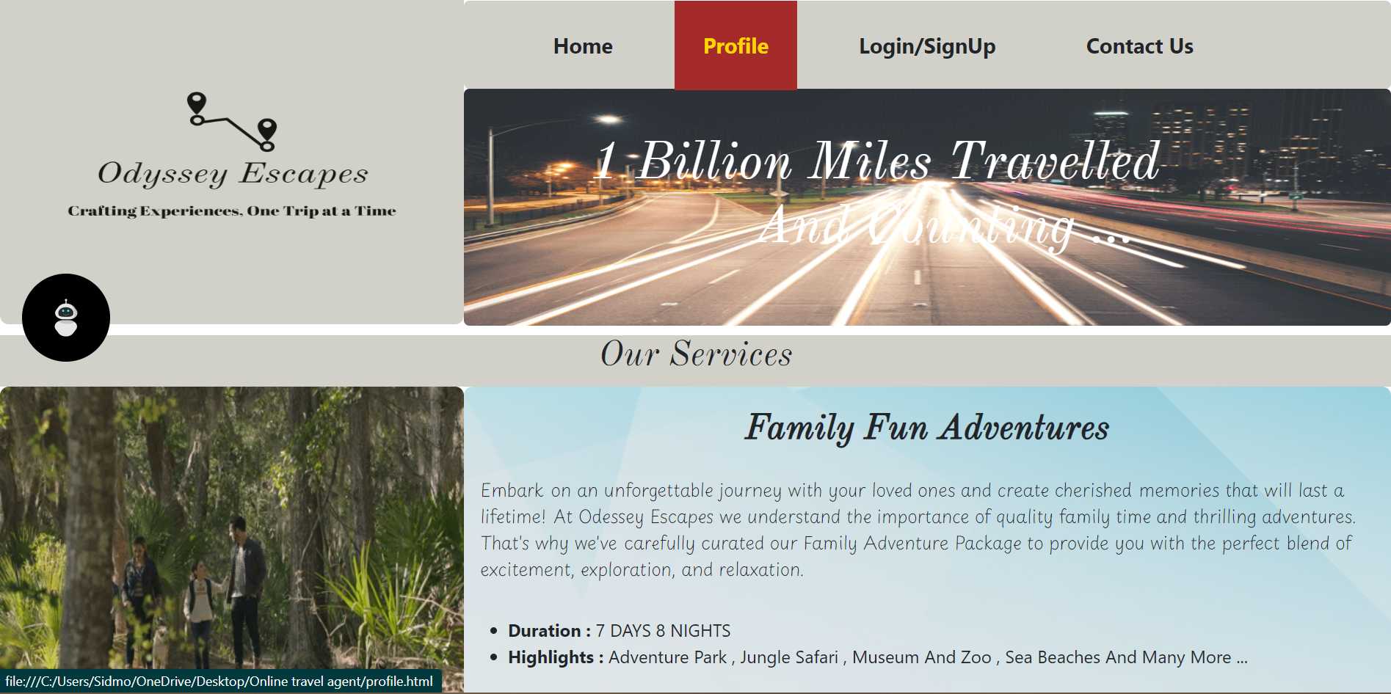

Slide 25
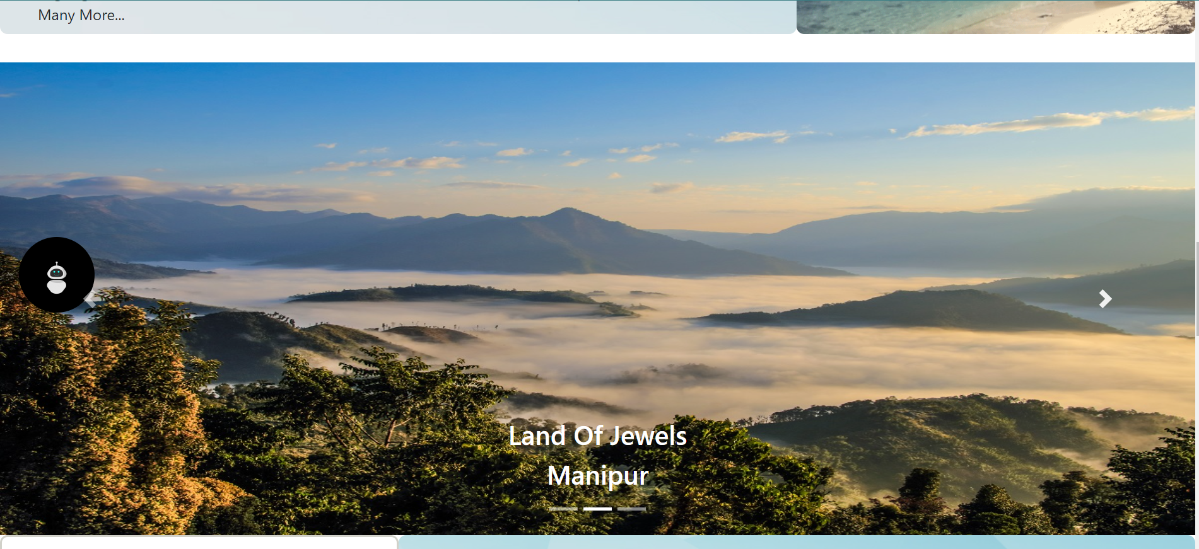
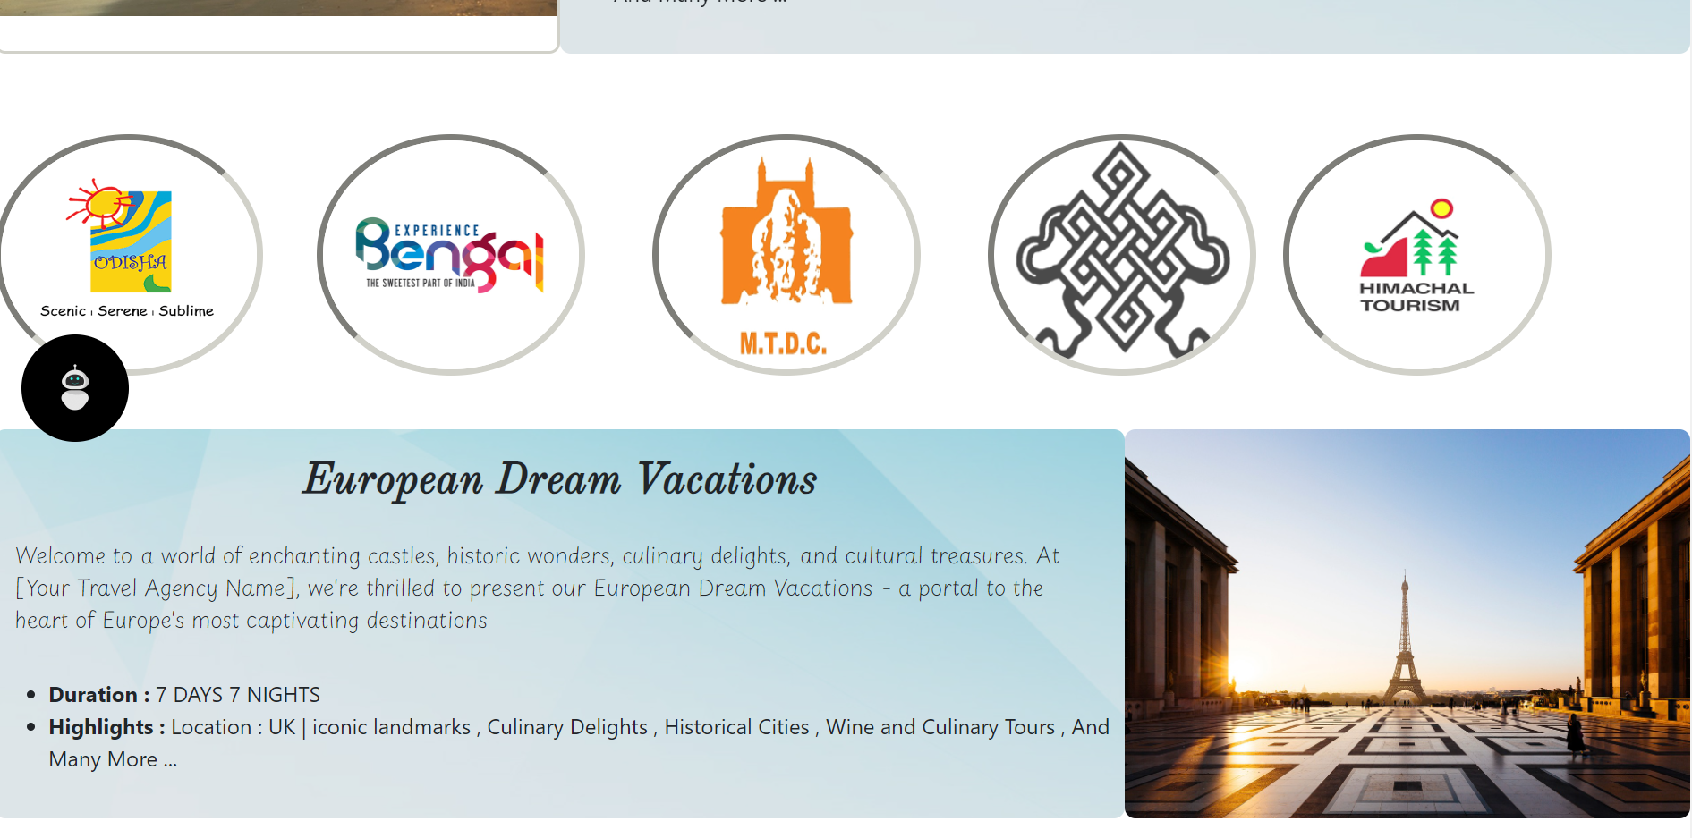

Slide 26
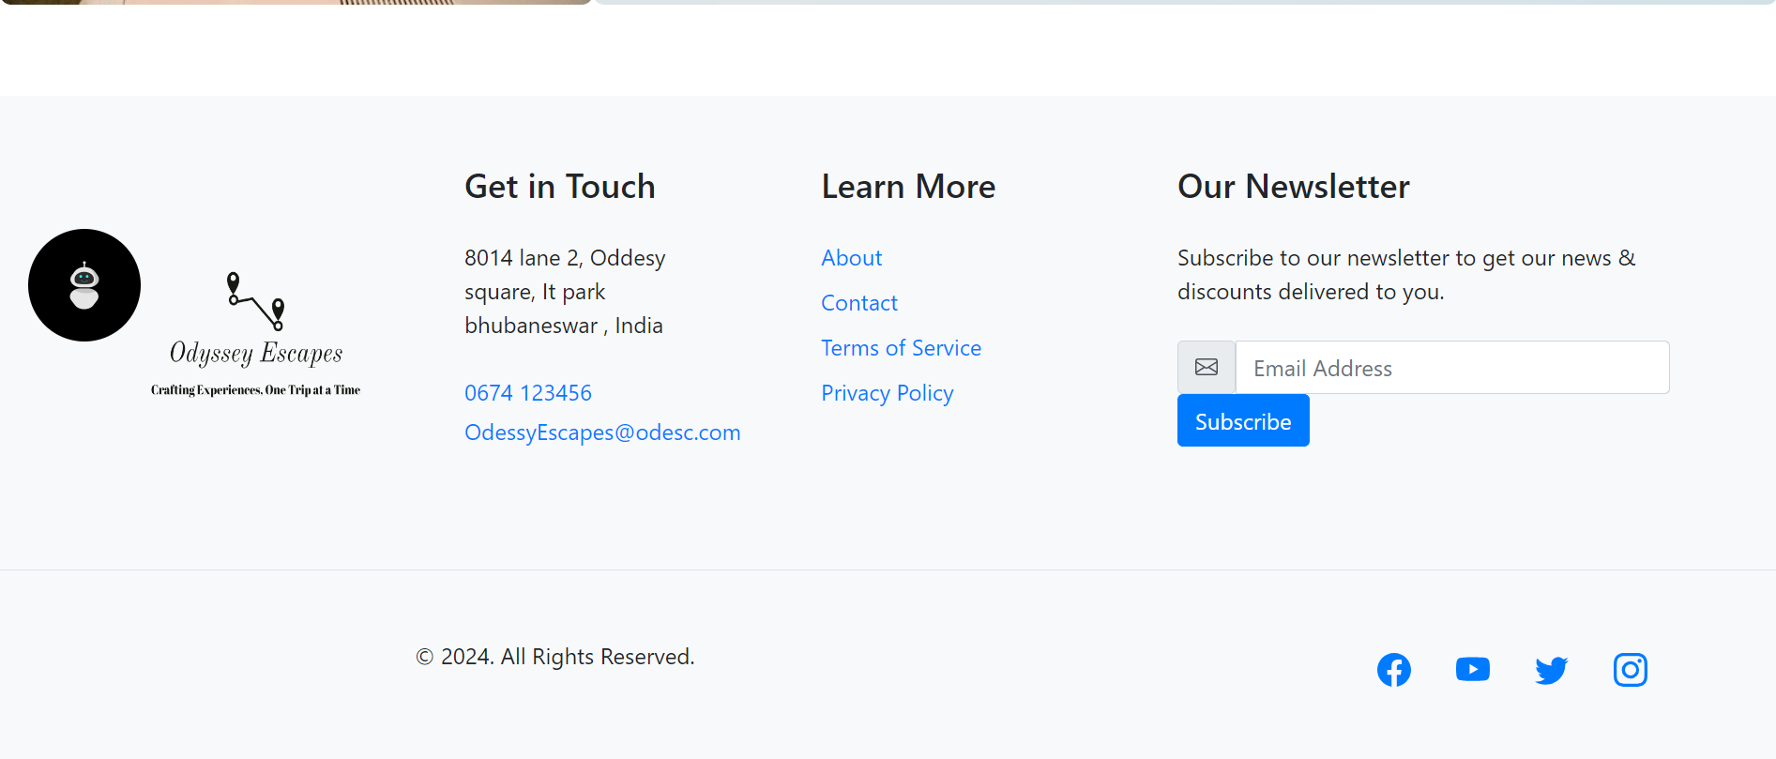

Slide 27
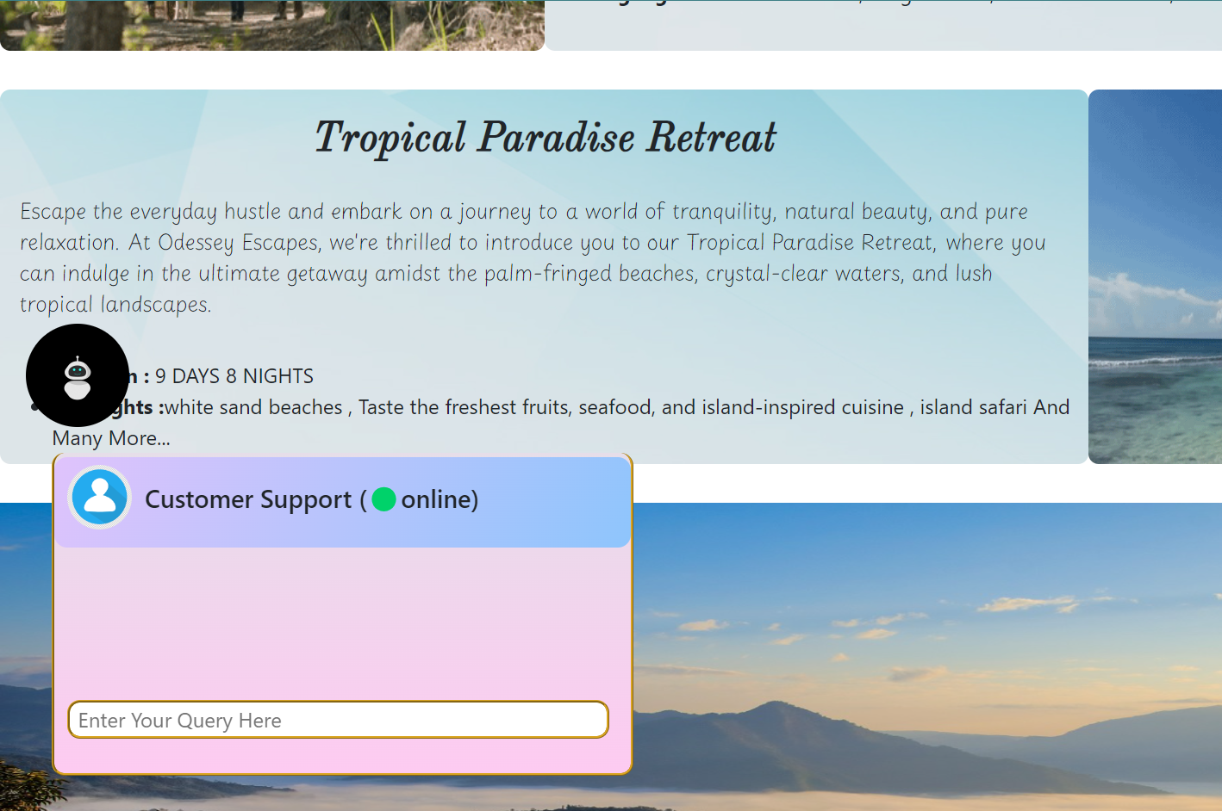

Slide 28
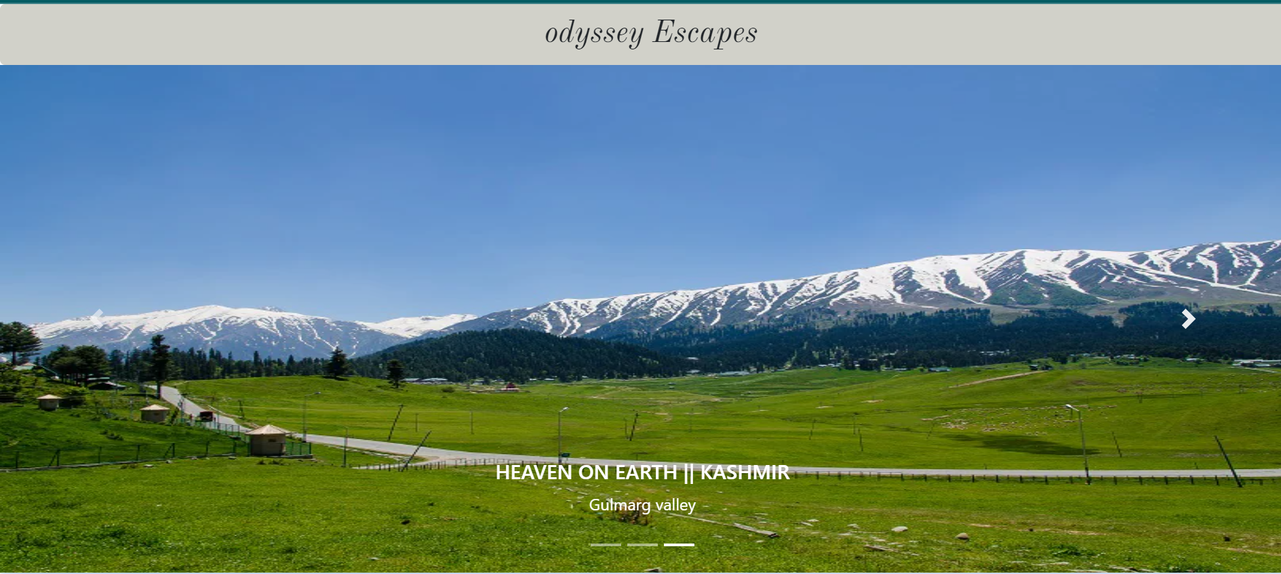

Slide 29
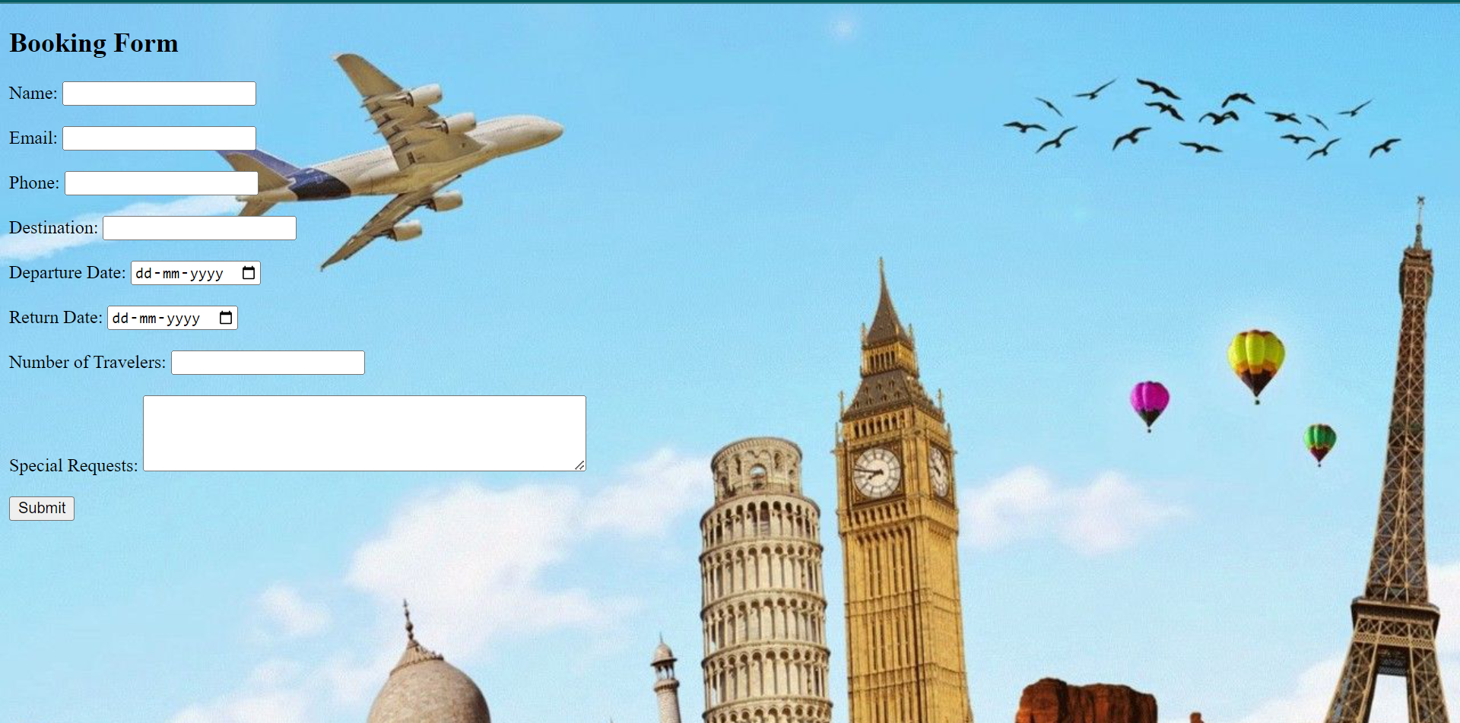

Slide 30
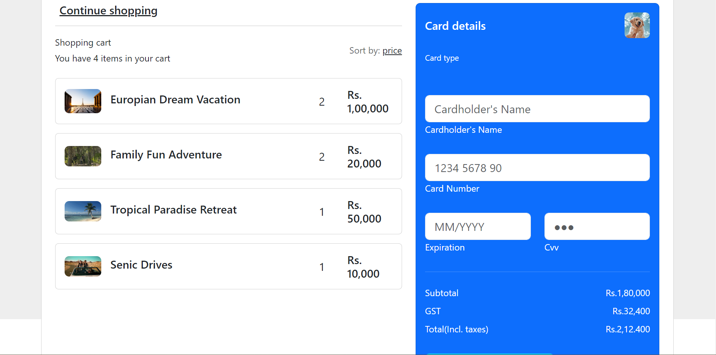

Slide 31
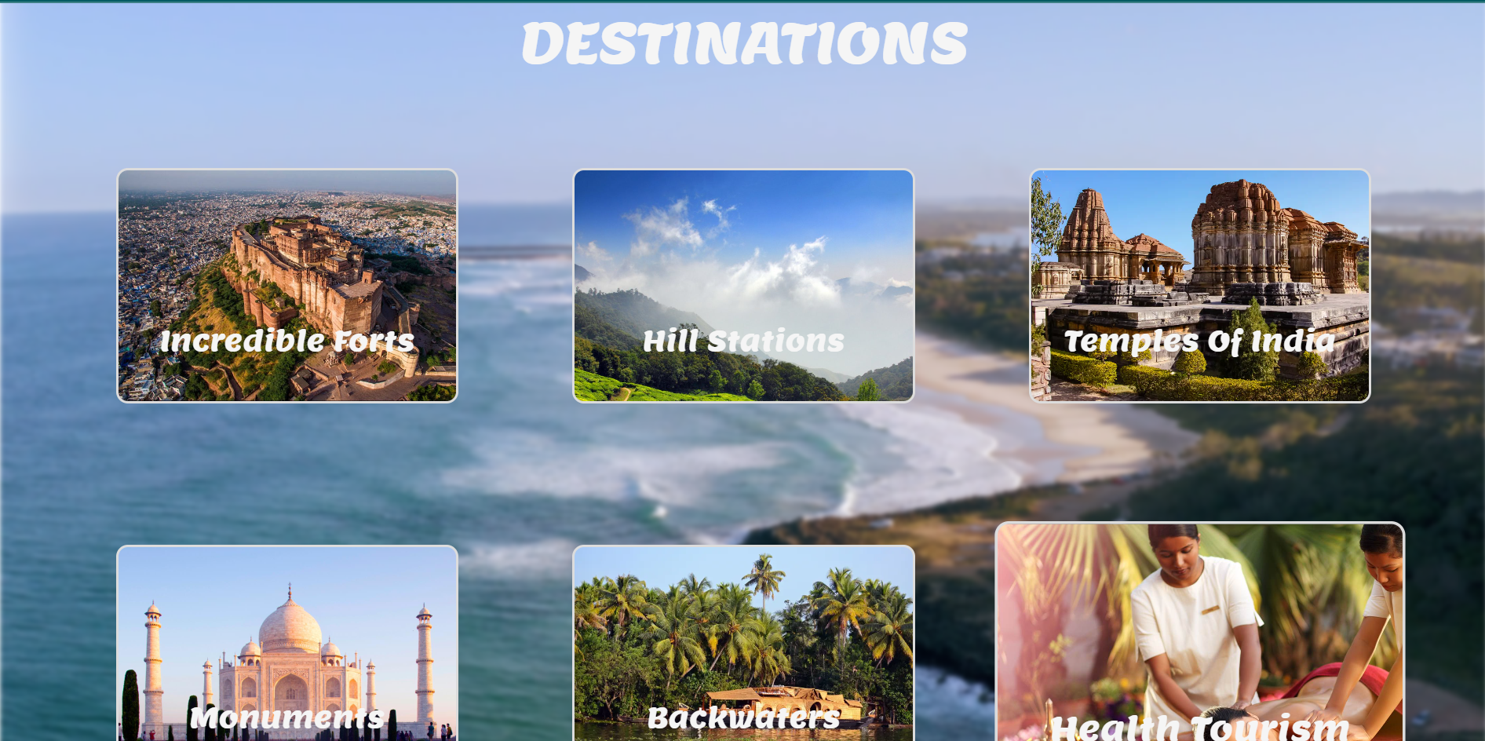

Slide 32
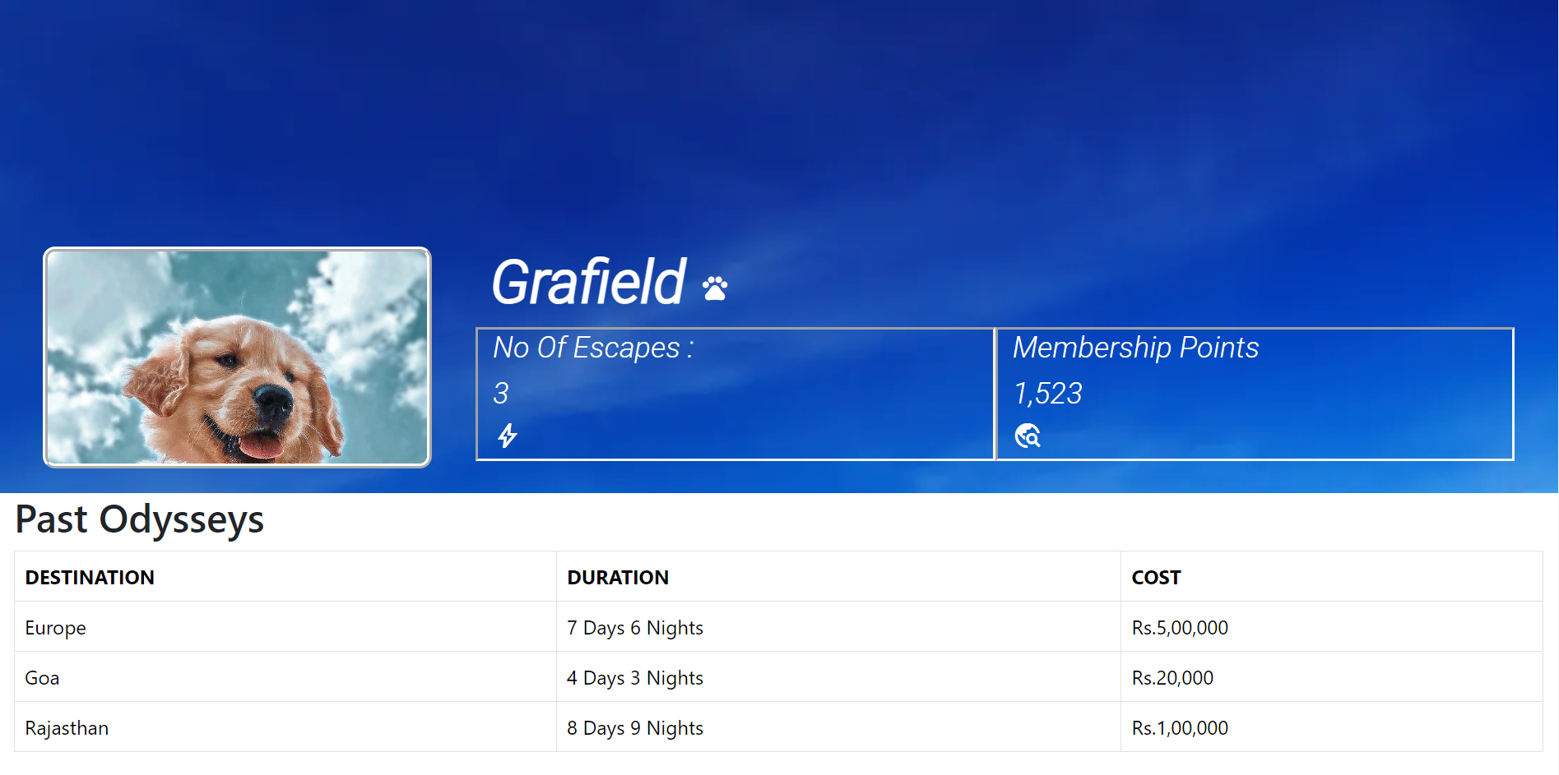

Slide 33
